Slide 1
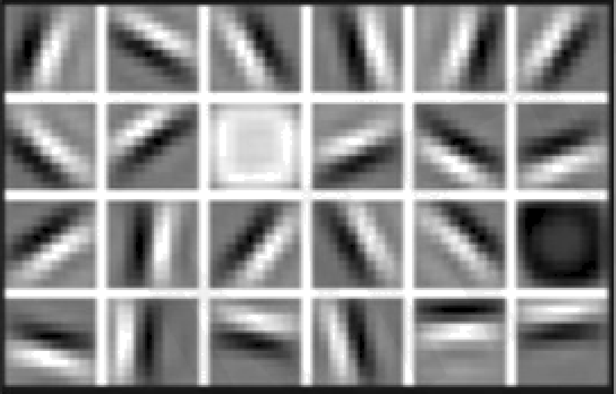
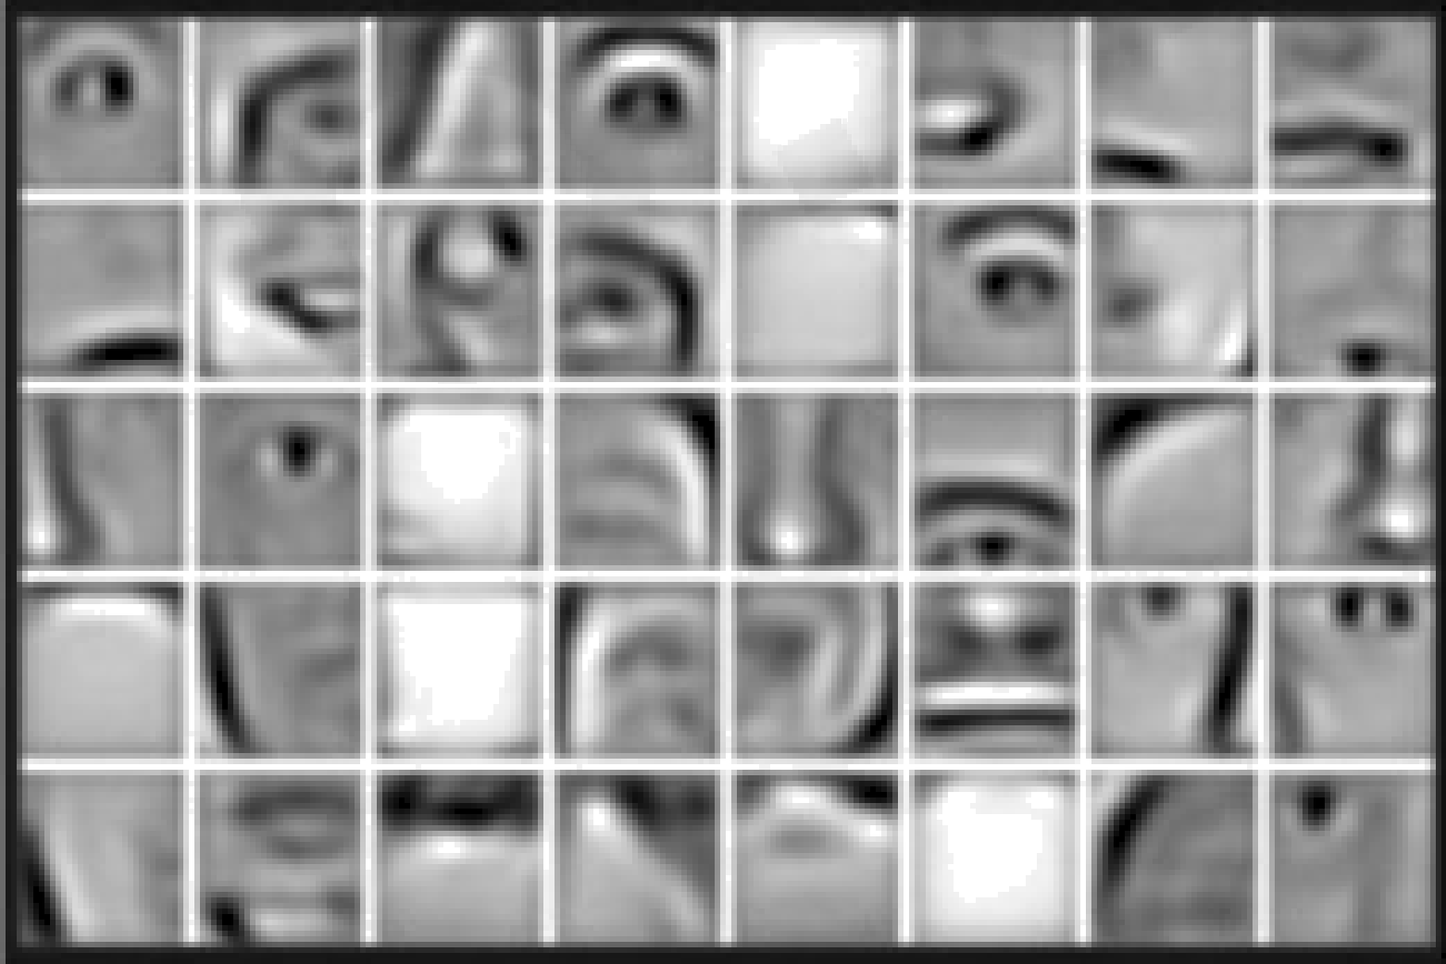
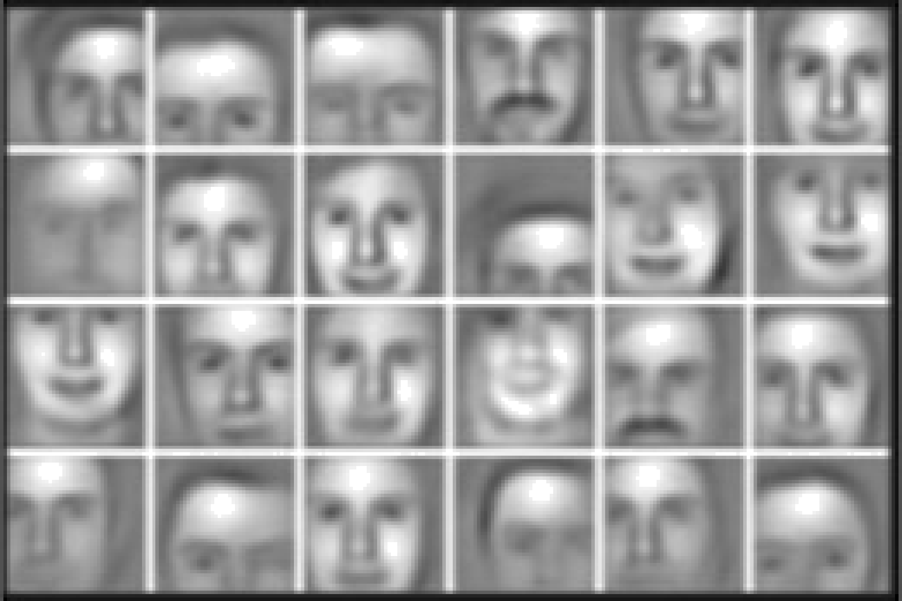
Why Deep Learning?
Hand engineered features are time consuming, brittle, and not scalable in practice.
Can we learn the underlying features directly from data?
Low Level Features
Mid Level Features
High Level Features
Lines & Edges
Eyes & Nose & Ears
Facial Structure
Notes:
Brittle – Fragile – نازک
traditional feature extractors (HOG, SIFT, ORB, etc.) do not extract high-level features the way CNNs do. They primarily capture low to mid-level features such as edges, corners, and keypoints.

Slide 2




Why Now?
Neural Networks date back decades, so why the dominance?
1952
Stochastic Gradient Descent
Big Data
Larger Datasets
Easier Collection & Storage
Hardware
Graphics Processing Units (GPUs)
Massively Parallelizable
Software
Improved Techniques
New Models
Toolboxes
1958
Perceptron
Learnable weights
1986
Backpropagation
Multi-Layer Perceptron
1995
Deep Convolutional NN
Digit Recognition
Notes:
Artificial Neuron: Inspired by the structure of the human brain.
Early research dates back to 1943 (McCulloch & Pitts models).
Lenet-5 → 1998
The process of computing gradients in a neural network is called back propagation.

Slide 3
The Perceptron The structural building block of deep learning

Slide 4

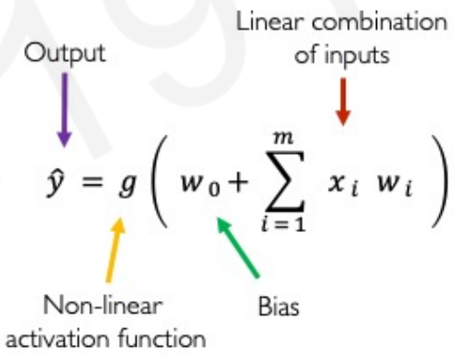








The Perceptron Forward Propagation
$$x_{1}$$
$$x_{2}$$
∑
ŷ
$$x_{m}$$
Inputs
Weights
Sum
Non-Linearity
Output
Notes:
a single artificial neuron performs either linear or logistic regression, depending on the activation function.
- If relu, tanh so non-linear transformation unit.

Slide 5
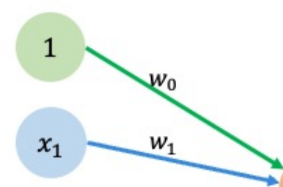
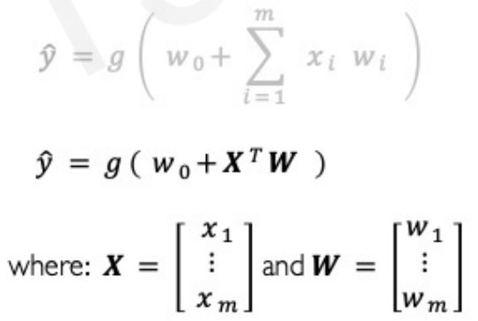



The Perceptron Forward Propagation
1
$$x_{1}$$
$$x_{2}$$
∑
ŷ
$$x_{m}$$
Inputs
Weights
Sum
Non-Linearity
Output

Slide 6
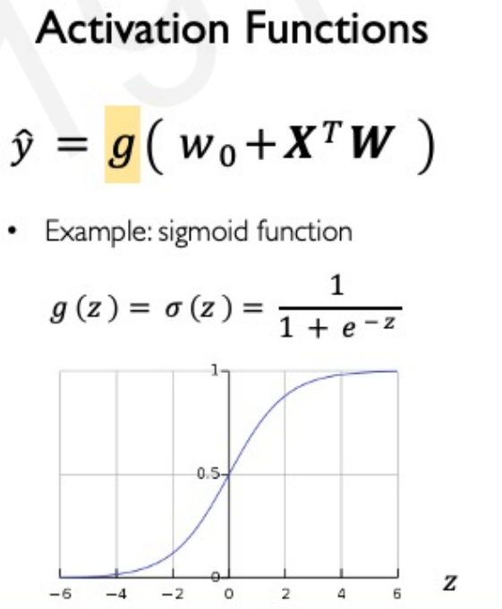
The Perceptron Forward Propagation
1
$$x_{1}$$
$$x_{2}$$
∑
ŷ
$$x_{m}$$
Inputs
Weights
Sum
Non-Linearity
Output
Notes:
One common example is sigmoid function.
Sigmoid function is really good for things like probabilities if you want to convert your output of your perceptron to a probability.

Slide 7
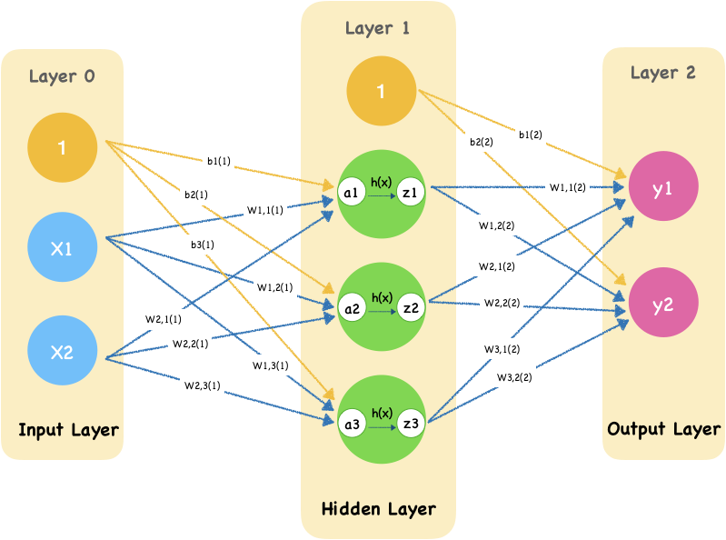
Forward Propagation
Forward propagation in a neural network refers to the process of passing input data through the network layers, applying activation functions at each neuron, and producing an output prediction at the final layer.
Process Overview:
Input data is provided to the input layer.
Weighted sum of inputs is calculated at each neuron.
An activation function is applied to introduce non-linearity.
The output of each layer serves as input to the next layer.
The final layer produces predictions.
Notes:
You can use different activation functions for different layers or even different neurons within a layer. The choice of activation function depends on the purpose of the layer.
Hidden layers: Typically use activation functions like ReLU (Rectified Linear Unit), Sigmoid, or Tanh to introduce non-linearity.
Output layer: The activation function depends on the task:
Sigmoid → for binary classification (output between 0 and 1).
Softmax → for multi-class classification (produces probability distribution).
Linear (Identity Function) → for regression problems.
Yes, the cost function is only calculated at the output layer, not in between layers.
The cost function measures how far the network's predictions are from the actual labels (ground truth).
It is computed by comparing the actual values with the predicted values from all neurons in the output layer.
The computed cost (or loss) is then used in backpropagation to update weights in earlier layers.
A weighted sum is the combination of input values multiplied by their respective weights, plus a bias term. It is mathematically represented as:
z=w1x1+w2x2+...+wnxn+b

Slide 8
Implementation of Forward Propagation in neural network using python
import numpy as np
def sigmoid(z):
return 1 / (1 + np.exp(-z))
# Input values
x = np.array([0.5, 0.8])
# Initialize weights and bias
w = np.array([0.2, 0.4])
b = 0.1
# Compute weighted sum
z = np.dot(x, w) + b
# Apply activation function
output = sigmoid(z)
print(“Final Output:”, output)

Slide 9
Neural Networks Training Process
To fit the parameters of a neural network to a given training dataset, we employ backpropagation combined with optimization techniques like gradient descent.
General Steps:
Initialize Parameters - Assign small random values to weights and biases.
Forward Propagation - Compute outputs layer by layer.
Compute Loss - Measure how far predictions are from actual values.
Backpropagation - Calculate gradients to adjust parameters.
Gradient Descent - Update weights to minimize the loss function.
Repeat - Iterate until convergence.
Evaluate - Assess performance using a test dataset.
Adjust Hyperparameters - Tune learning rate, batch size, etc.
Test - Validate the final model.

Slide 10
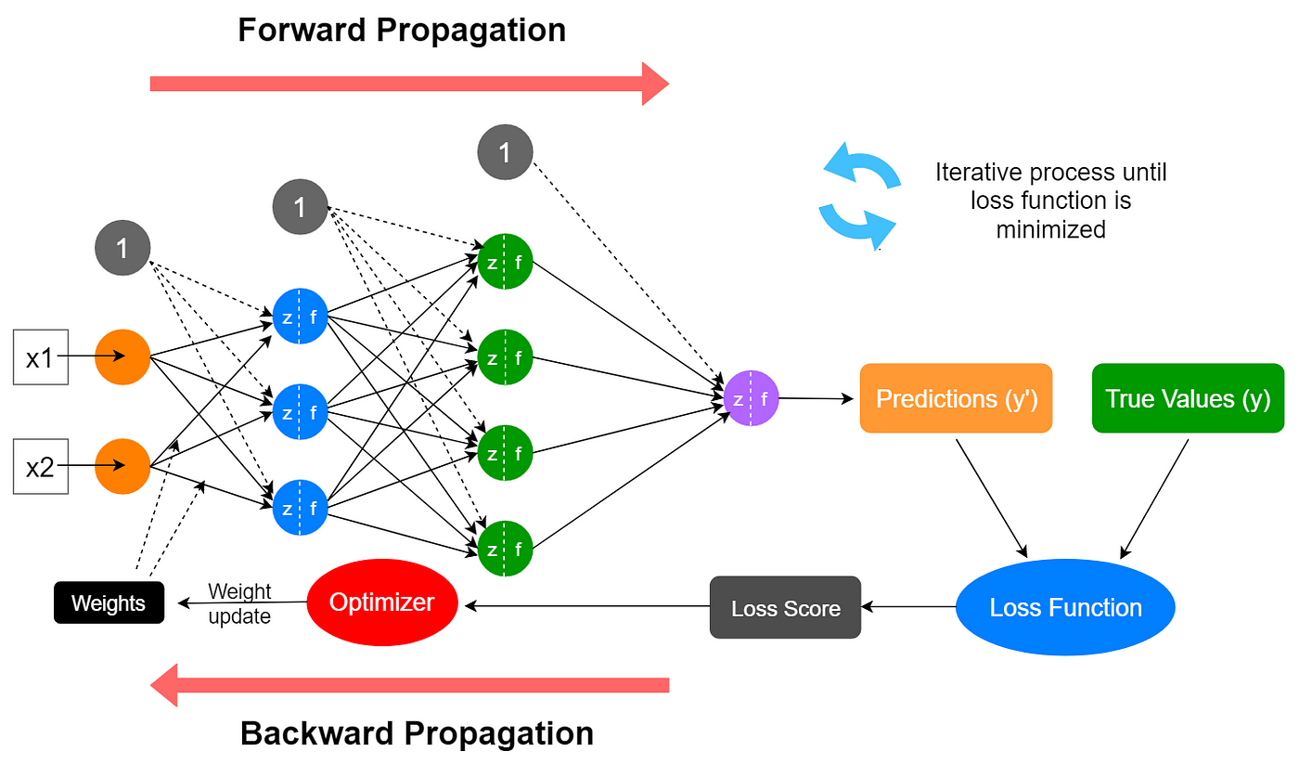
Neural Networks Training Process

Slide 11
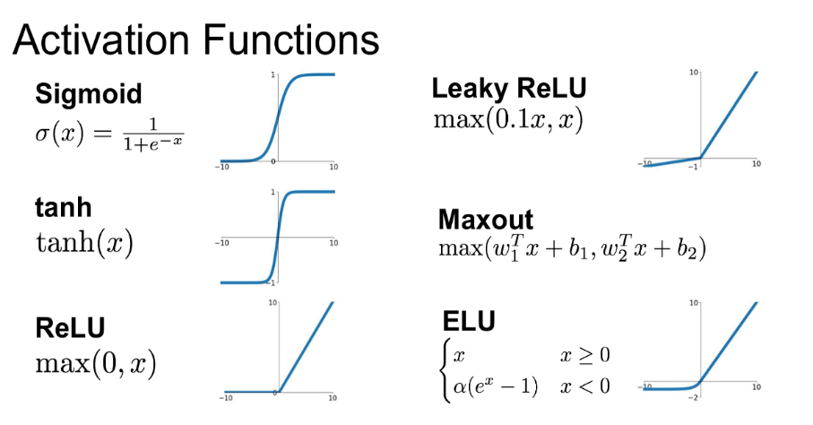
Activation Functions
Activation functions introduces non-linearity, allowing neural networks to learn complex patterns.
Common Activation Functions
Notes:
Activation functions are mathematical functions applied to neural network outputs to introduce non linearity, enabling the network to learn complex patterns.

Slide 12
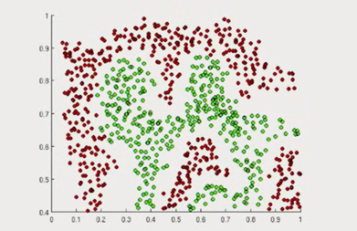
Importance Activation Functions
The purpose of activation functions is to introduce non-linearity into the network
What if we wanted to build a neural network to distinguish green vs red points?

Slide 13
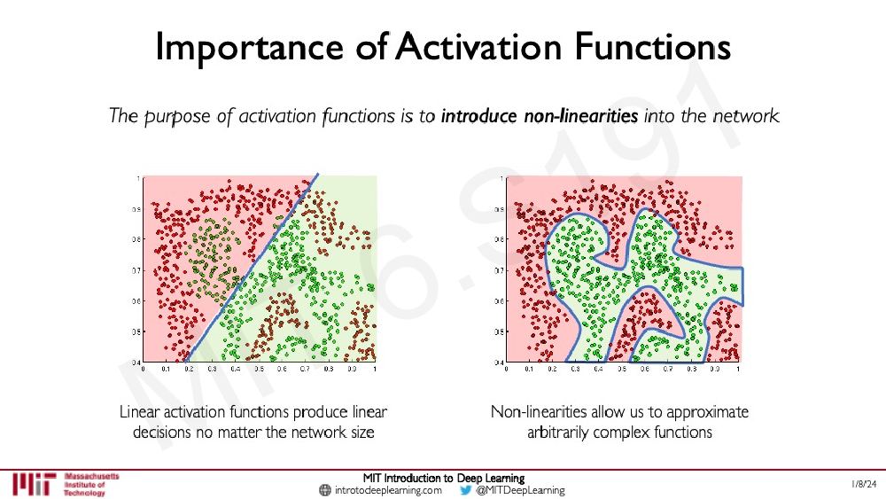
Importance Activation Functions
The purpose of activation functions is to introduce non-linearity into the network
Linear activation functions produce linear decisions no matter the network size
Non-linearities allow us to approximate arbitrarily complex functions

Slide 14
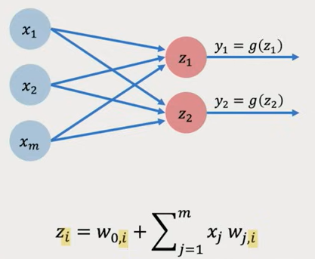
Multi Output Perceptron
Because all inputs are densely connected to all outputs , these layers are called Dense layers.
Notes:
Everything in my input is connected to everything in my output.

Slide 15
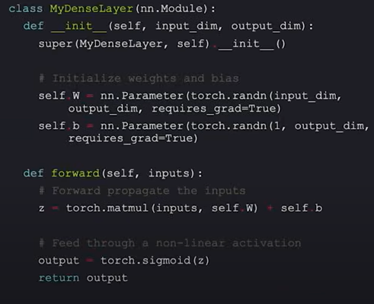
Dense layer from scratch

Slide 16

Dense layer from scratch
import torch.nn as nn
layer = nn.Linear(in_features=m, out_features=2)
import tensorflow as tf
layer = nn.keras.layers.Dense(
units=2
Notes:
You can just call it.

Slide 17
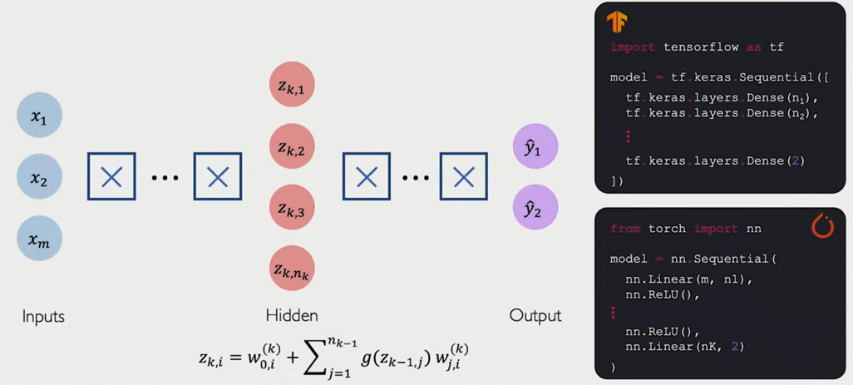
Deep Neural Network

Slide 18
Loss Function / Cost Function in Deep Learning
Loss Function:
A loss function measures the difference between the predicted output and the actual target.
It helps the neural network adjust weights during training to minimize errors.
Cost Function:
The cost function is the average of the loss function over the entire dataset.
It provides a single scalar value to optimize the model.
loss = torch.nn.functional mse_loss( predicted, y )
Types of Loss Functions in Neural Networks
Loss Function | Type | Use Case
Mean Squared Error (MSE) | Regression | Penalizes large errors, used for continuous values
Mean Absolute Error (MAE) | Regression | More robust to outliers than MSE
Binary Cross-Entropy | Classification | For binary classification (e.g., Yes/No, 0/1)
Categorical Cross-Entropy | Classification | For multi-class classification (e.g., Image Recognition)
Huber Loss | Regression | Combines MSE and MAE, handles outliers well
Notes:
Optimization Goal: Minimize the cost function using gradient descent or its variants (SGD, Adam, RMSprop).

Slide 19
Training Neural Networks

Slide 20
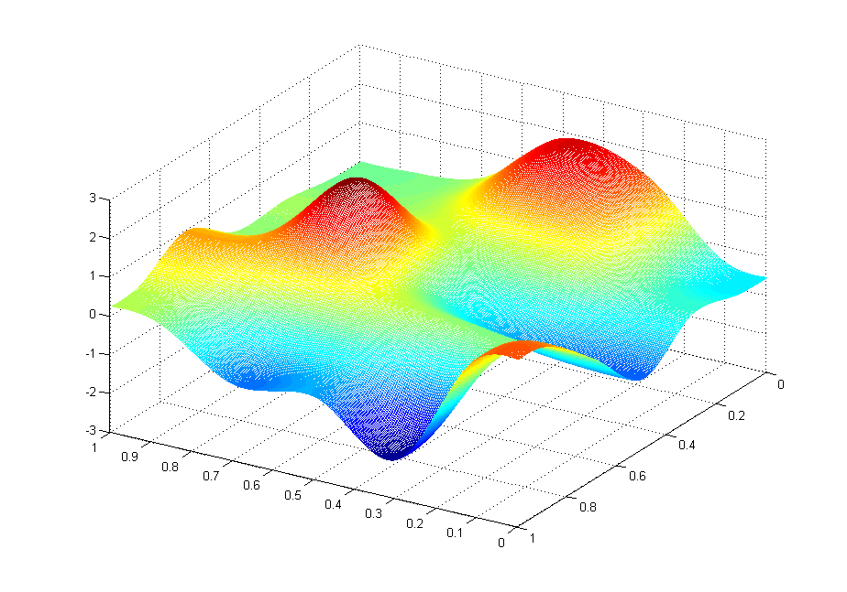
Loss Optimization
We want to find the network weights that achieve the lowest loss
J(θ₀,θ₁)
θ₁
θ₀
Notes:
Minimize loss on the dataset.
We want to find the weights that will result in the minimum loss over the entire dataset from 1 to m.
- Randomly pick an initial (theta0, theta1)
- Computer gradient, (d J(theta)/d(theta))
Repeat until convergence.
Gradient Descent Algorithm

Slide 21
Backpropagation
Backpropagation is an algorithm used to minimize the cost function by updating weights based on the error obtained at the output layer.
Key Steps:
Perform forward propagation.
Compute loss at the output layer.
Compute gradients of the loss with respect to weights using chain rule.
Propagate these gradients backward to update weights.
Repeat until convergence.
Important Notes:
Backpropagation adjusts weights using partial derivatives.
It enables efficient training by distributing errors backward.
Notes:
The process of computing gradients in a neural network is called back propagation.
Perceptron -> Single neuron
The purpose of activation function is to introduce non-linearities into the network.
How a perceptron works:
Take dot product of inputs and weights
Add a bias
Apply non-linearity

Slide 22
Optimization Algorithms for Training Neural Networks
What is Optimization in Deep Learning?
Optimization algorithms adjust model parameters (weights) to minimize the loss function.
Efficient optimization ensures faster convergence and better model performance.
Popular Optimization Algorithms
Algorithm | Type | Characteristics
Stochastic Gradient Descent (SGD) | First-order | Updates weights using a single data point, faster but noisy
Momentum-based SGD | First-order | Adds momentum to reduce oscillations and speed up convergence
Adam (Adaptive Moment Estimation) | Adaptive | Combines momentum and adaptive learning rates, widely used
RMSprop | Adaptive | Adjusts learning rates for each parameter, effective for deep networks
Adagrad | Adaptive | Adapts learning rate based on past gradients, suitable for sparse data
Notes:
🔹 Choosing the Right Algorithm: Depends on dataset size, model complexity, and training speed requirements.
First-order:
Adaptive:

Slide 23
Neural Networks in Practice: Overfitting
Notes:
It is a huge problem not just in deep learning but it is one of the most fundamental topics of all of the machine learning as a whole.

Slide 24
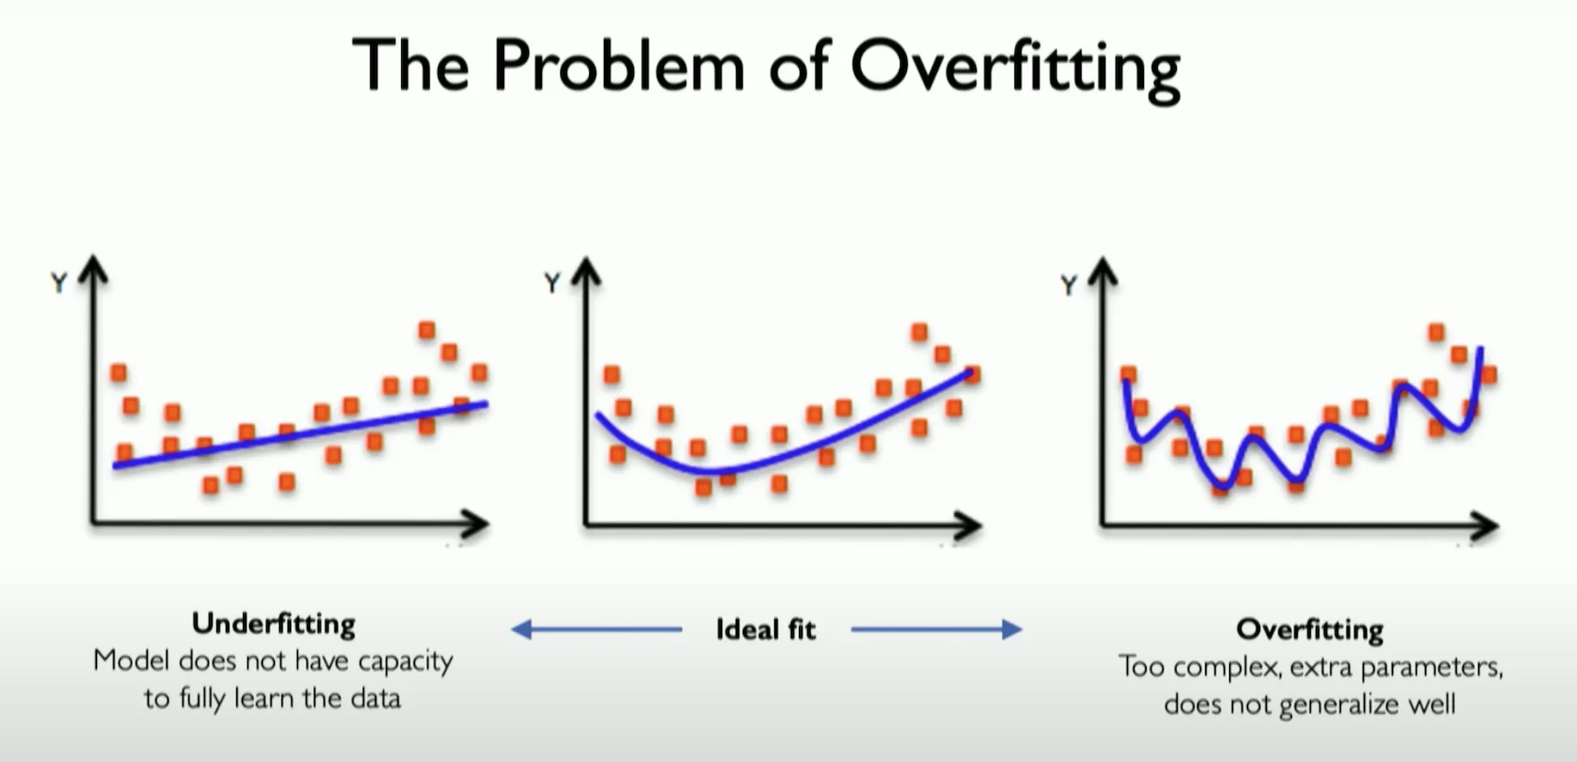

The Problem of Overfitting
Under fitting
Ideal fit
Overfitting
Model does not have capacity to fully learn the data
Too complex, extra parameters, does not generalize well

Slide 25
Overfitting
Overfitting occurs when a model learns noise and patterns specific to the training data but fails to generalize to new data.
It leads to high accuracy on training data but poor performance on test data.
Causes of Overfitting
Too complex a model with excessive parameters.
Insufficient training data.
Lack of regularization techniques.
Techniques to Prevent Overfitting
Method | Description
L1 Regularization (Lasso) | Adds absolute values of weights to the loss function, promotes sparsity by reducing less important weights to zero.
L2 Regularization (Ridge) | Adds squared values of weights to the loss function, prevents large weights and improves generalization.
Dropout | Randomly disables a fraction of neurons during training to reduce reliance on specific features.
Early Stopping | Stops training when validation performance starts to degrade, preventing overfitting.
Data Augmentation | Expands training data by applying transformations (rotation, flipping, scaling) to improve generalization.
Notes:
Balancing Model Complexity and Generalization: Properly tuning hyperparameters and applying regularization techniques ensures a well-generalized neural network.

Slide 26
Regularization
What is it?
Technique that constraint our optimization problem to discourage complex models
Why do need it?
Improve generalization of our model on unseen data
Notes:
Drop out: During training randomly set some activation to 0.

Slide 27
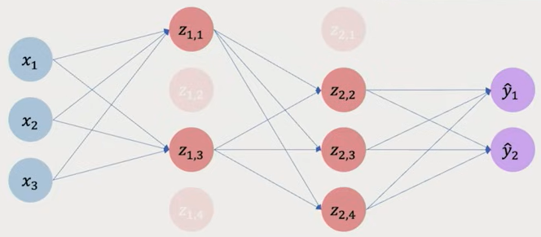
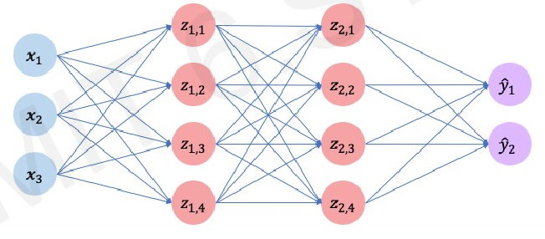
Regularization I: Dropout
During training, randomly set some activations to 0
torch.nn.Dropout(p=0.5)
Notes:
Typically ‘drop’ 50% of activations in layer.

Slide 28
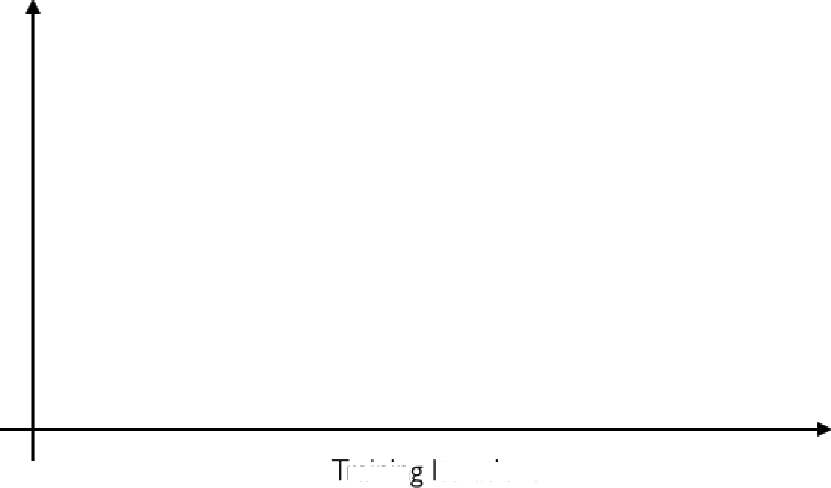
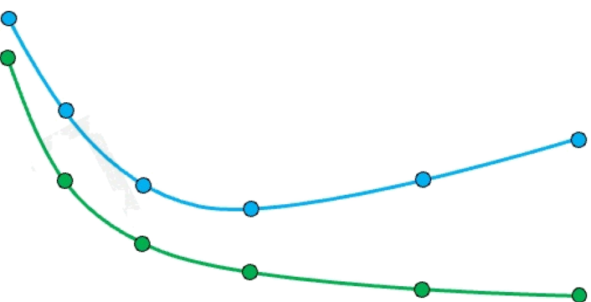
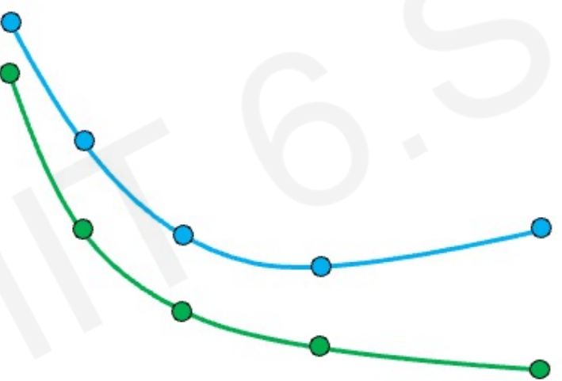
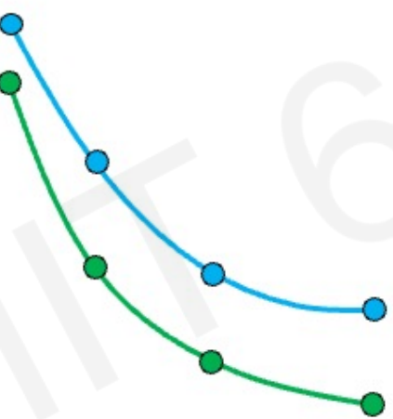
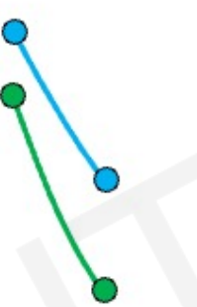
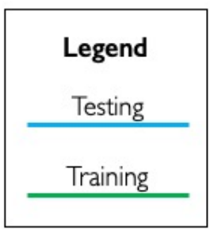
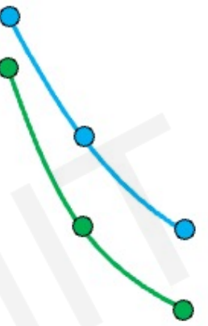
Regularization 2: Early Stopping
Stop training before we have a chance to overfit
Under-fitting
Over-fitting
Stop training here
Loss
Training Examples

Slide 29
Modern Deep Learning Architectures

Slide 30
Modern Deep Learning Architectures
Deep learning has evolved into powerful, specialized architectures:
Architecture | Purpose | Example Use
CNNs (Convolutional Neural Networks) | Extract patterns from images using filters | Image classification, object detection
RNNs (Recurrent Neural Networks) | Handle sequential data with memory | Language modeling, time series
Transformers | Attention-based, parallelized learning for sequences | ChatGPT, translation, summarization
GANs (Generative Adversarial Networks) | Learn to generate realistic data by competition | Deepfakes, image synthesis
Multimodal Models | Process multiple input types (text, image, audio) together | Text-to-image, video Q&A, agents

Slide 31
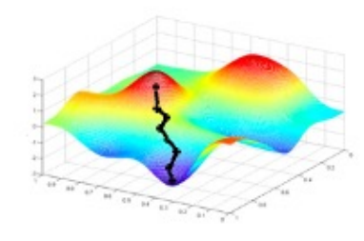
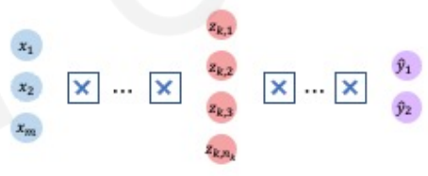




Core Foundation Review
The Perceptron
Neural Networks
Training in Practice
Structural building blocks
Nonlinear activation functions
Stacking Perceptrons to form neural network
Optimization through backpropagation
Adaptive learning
Batching
Regularization
$$x_{1}$$
$$x_{2}$$
∑
ŷ
$$x_{m}$$

Slide 32
Thank You

